Slide 1
Data Science Capstone – Comparing Restaurant Diversity in Toronto and New York
By: Ahmed Mashhour

Slide 2
Restaurant Data Acquisition
Use postal code locations as center points for Foursquare venue search
Find the best search radius to cover entire cities with postal code locations alone
Return venue data, clean and analyze for graphing

Slide 3
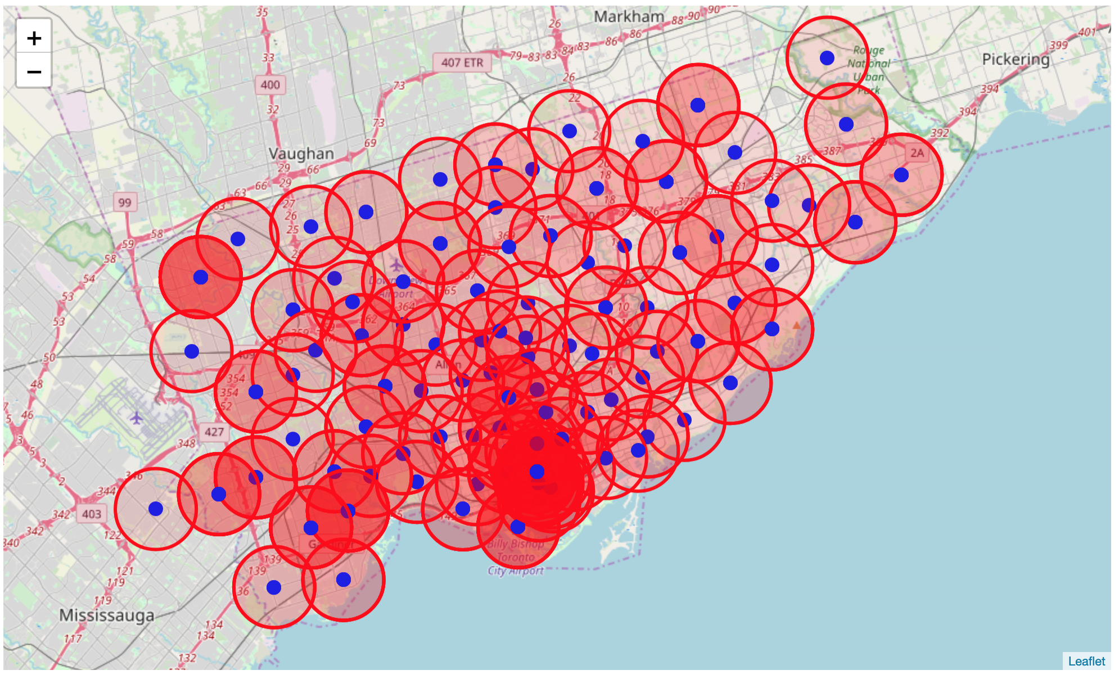
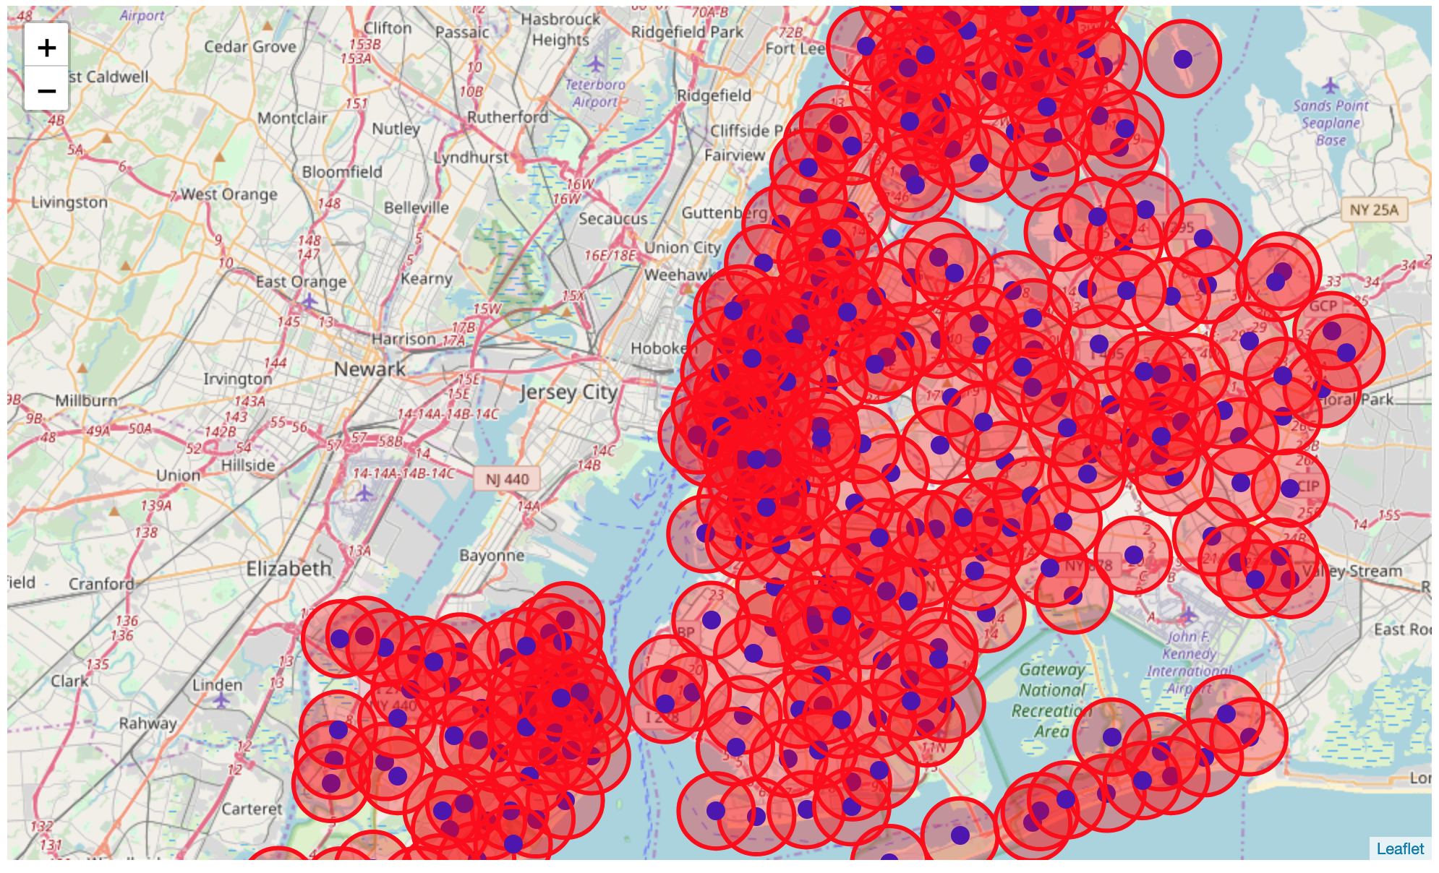
Foursquare search area
Toronto: radius=2000m
New York: radius=1500m

Slide 4
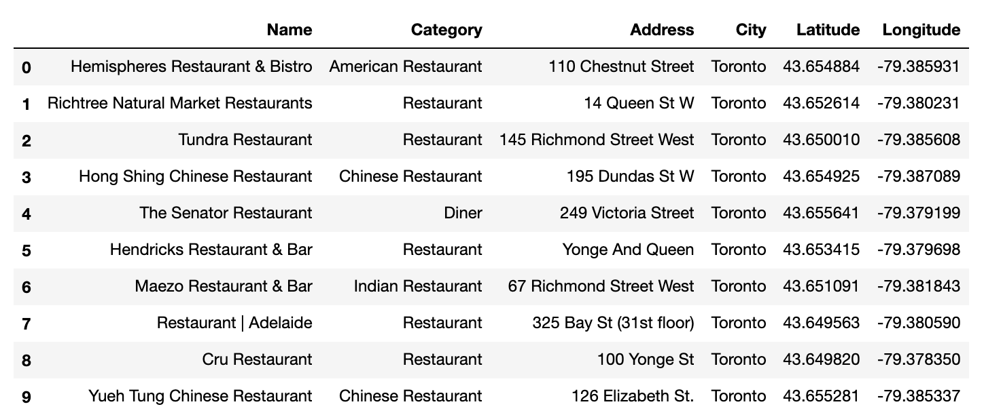
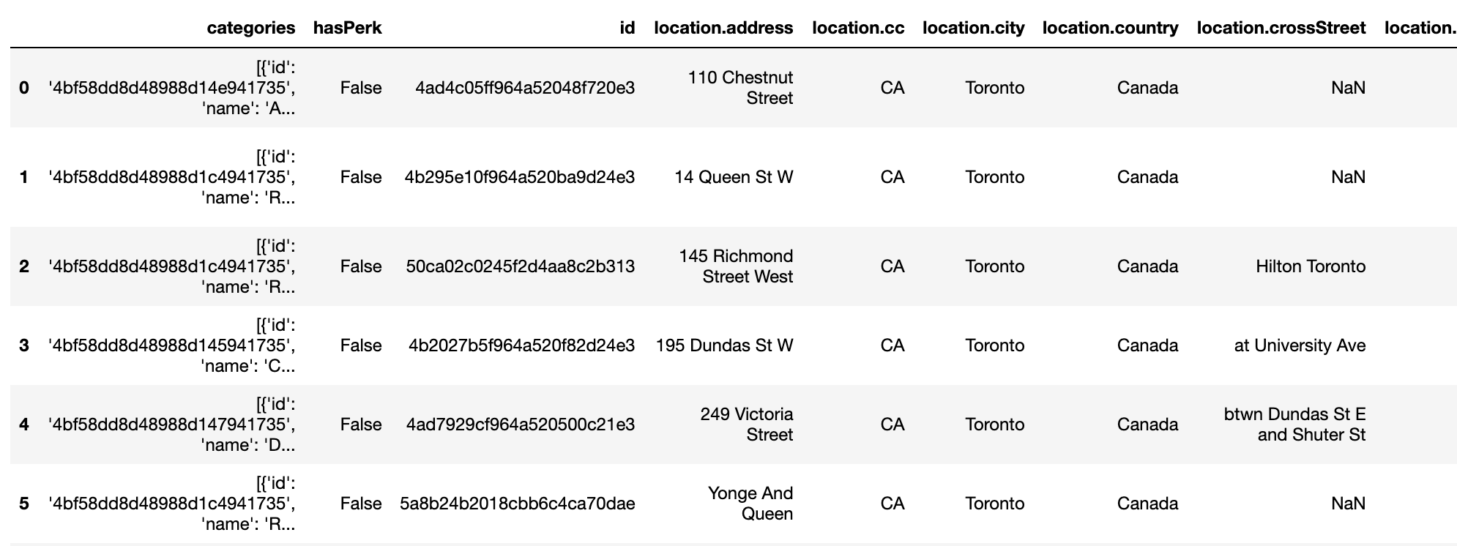
Data Return and Cleaning

Slide 5
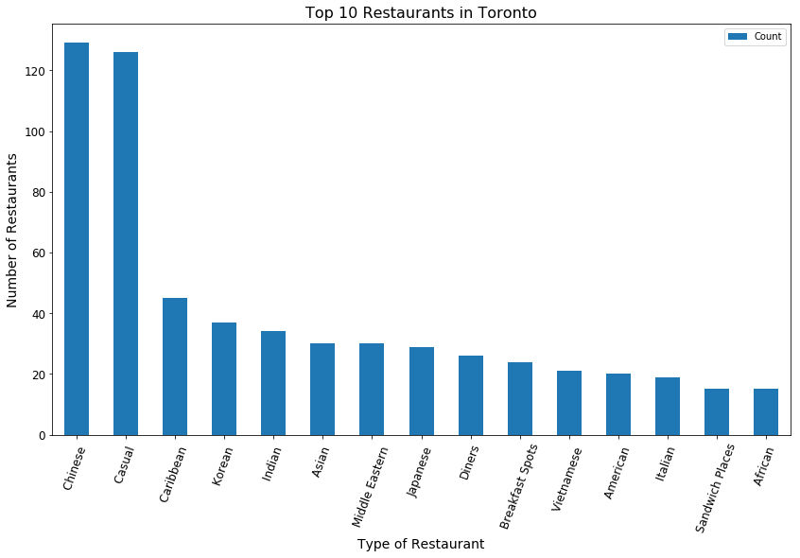
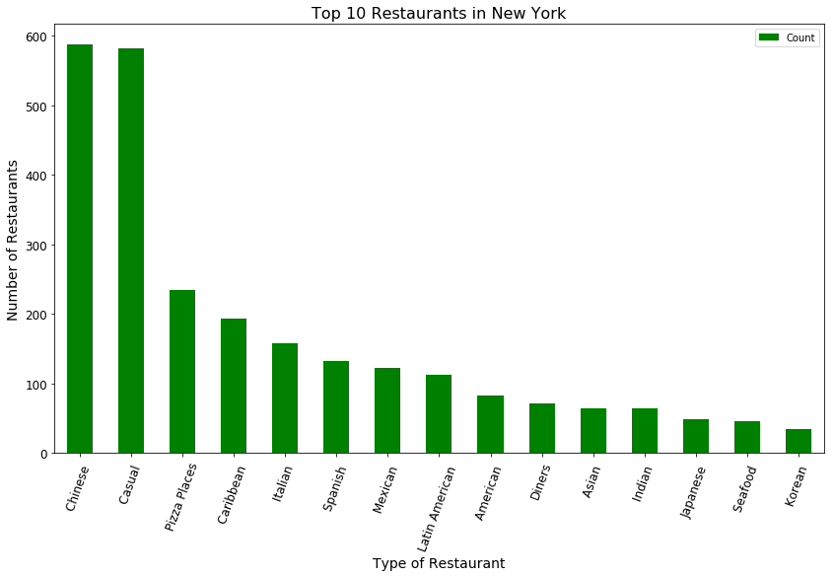
Final Results

